Slide 1

DTC Dentistry
By Josh High
https://dtcdentistry.ddns.net

Slide 2


Slide 3
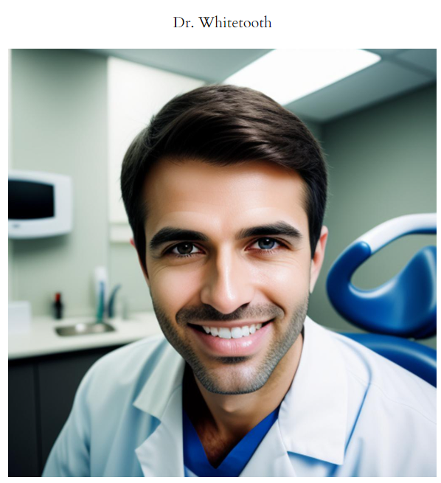
Dr. James Whitetooth, DDS
Meet Dr. James Whitetooth, DDS, a distinguished figure in the field of dentistry with a remarkable track record of fulfilling a wide array of dental needs with utmost professionalism. Dr. Whitetooth’s journey in dentistry began with his graduation from a renowned dental school, where he excelled both academically and in clinical practice.
With over a decade of experience, Dr. Whitetooth has mastered the art and science of dentistry. He is renowned for his technical precision, innovative approach, and a deep understanding of the latest dental techniques and technologies. His expertise spans from routine dental care to complex cosmetic and restorative procedures, making him a one-stop solution for all dental concerns.
Dr. Whitetooth’s practice is built on a foundation of trust and excellence. He believes in creating a personalized experience for each patient, understanding that each individual’s dental needs are unique. His approach is holistic; he not only addresses dental issues but also educates his patients on maintaining optimal oral health, thus fostering a proactive attitude towards dental care.
His clinic is a testament to his commitment to quality care, equipped with state-of-the-art dental technology. This, combined with his meticulous skill, ensures that every procedure, whether a simple cleaning or a sophisticated implant, is performed to the highest standards.
Patients often commend Dr. Whitetooth for his ability to make dental visits a comfortable and stress-free experience. His warm, friendly demeanor and clear communication help ease the anxieties often associated with dental procedures. He is particularly adept at working with patients who have dental phobias, ensuring they feel safe and relaxed throughout their treatment.

Slide 4

Dr. Colette Early, DDS
Dr. Colette Early, DDS, stands as a beacon of excellence in the dental community, renowned for her exceptional skills, innovative techniques, and compassionate approach to patient care. With a career that spans over fifteen years, Dr. Early has established herself not only as a highly skilled dentist but also as a visionary in her field.
A graduate of a prestigious dental school, Dr. Early distinguished herself early in her career through her meticulous attention to detail and her profound commitment to patient well-being. Her expertise covers a wide range of dental procedures, with a particular focus on cosmetic dentistry, where she has been recognized for her ability to transform smiles with artistry and precision.
Dr. Early’s practice is grounded in the philosophy that excellent dental care is a blend of science, art, and personalized attention. She is known for her holistic approach, considering each patient’s overall health and individual needs when crafting their dental care plans. This patient-centric focus has earned her a loyal patient base who value not just her technical prowess but her empathetic and understanding nature.
In the realm of cosmetic dentistry, Dr. Early has been a pioneer, adopting and refining new techniques that enhance both the aesthetic and functional aspects of dental treatments. Her work in this area has not only benefited her patients but also advanced the practice of cosmetic dentistry as a whole.
Beyond her clinical excellence, Dr. Early is a respected leader and mentor in the dental community. She frequently participates in dental symposiums and workshops, sharing her knowledge and experiences with peers and young professionals. Her research and articles on various aspects of dental health and innovations have been published in leading dental journals.

Slide 5

Services
Preventive Care:
  Routine Check-ups and Cleanings: Regular dental examinations, including X-rays when necessary, to monitor oral health. Professional cleanings to remove plaque and tartar build-up that can’t be eliminated by brushing and flossing alone.
  Oral Cancer Screenings: Early detection of any signs of oral cancer, vital for effective treatment.
  Dental Sealants and Fluoride Treatments: These help protect teeth, especially in children, from decay.
Restorative Care:
  Fillings: Treatment for cavities, using materials like composite resin or amalgam to restore the integrity of the tooth.
  Crowns and Bridges: Custom-made restorations for damaged or missing teeth. Crowns cover a damaged tooth or a dental implant, while bridges span the space where one or more teeth are missing.
  Dentures and Partial Dentures: Replacement options for missing teeth, ranging from full dentures (for complete tooth loss) to partials for those who still have some natural teeth.
  Root Canal Therapy: Treatment for infected or inflamed tooth pulp, saving a tooth that might otherwise need to be extracted.
Cosmetic Dentistry:
  Teeth Whitening: Professional bleaching services to brighten and whiten teeth.
  Veneers: Thin, custom-made shells designed to cover the front surface of teeth to improve appearance.
  Orthodontics: Including traditional braces and clear aligners like Invisalign, for teeth straightening and correcting bite issues.
Implant Dentistry:
  Single Tooth Implants: For replacing a missing tooth without affecting neighboring teeth.
  Implant-Supported Bridges: Ideal for multiple missing teeth, offering a more stable solution than traditional bridges.
  All-on-4 Implants: A full-arch restoration using only four implants, providing a permanent, screw-retained replacement for the entire upper and/or lower set of teeth.
Orthodontics:
  Traditional Braces: Metal braces for effective teeth straightening.
  Ceramic Braces: Less noticeable than metal braces, using clear or tooth-colored brackets.
  Lingual Braces: Custom-made braces placed on the backside of teeth, hidden from view.
  Invisalign: Clear aligners, a less visible and removable alternative to braces.

Slide 6
Other Services
Emergency Dental Services:
Toothache Relief: Immediate care for sudden and severe tooth pain.
Broken, Chipped, or Knocked-Out Tooth: Urgent treatment to repair or save a damaged tooth.
Emergency Extractions: Safe removal of a tooth that cannot be saved due to severe damage or infection.
Specialized Services:
Periodontal Care: Treatment for gum diseases like gingivitis and periodontitis.
TMJ/TMD Treatment: Solutions for problems associated with the temporomandibular joint.
Oral Surgery:
Tooth Extractions: Safe removal of damaged or decayed teeth, including wisdom teeth.
Bone Grafting: For patients who lack sufficient natural bones for dental implants.
Corrective Jaw Surgery: To correct a wide range of skeletal and dental irregularities.
Sedation Dentistry:
Nitrous Oxide (Laughing Gas): Mild sedative for relaxation during dental procedures.
Oral Sedatives: Prescribed before the dental appointment to reduce anxiety.
IV Sedation: For more complex procedures or higher levels of anxiety.
Pediatric Dentistry:
Preventive Care and Education: Focusing on early detection and teaching good oral hygiene habits.
Dental Sealants and Fluoride Treatments: To protect young teeth from decay.
Orthodontic Evaluation: Early assessment for potential teeth alignment issues

Slide 7


Slide 8
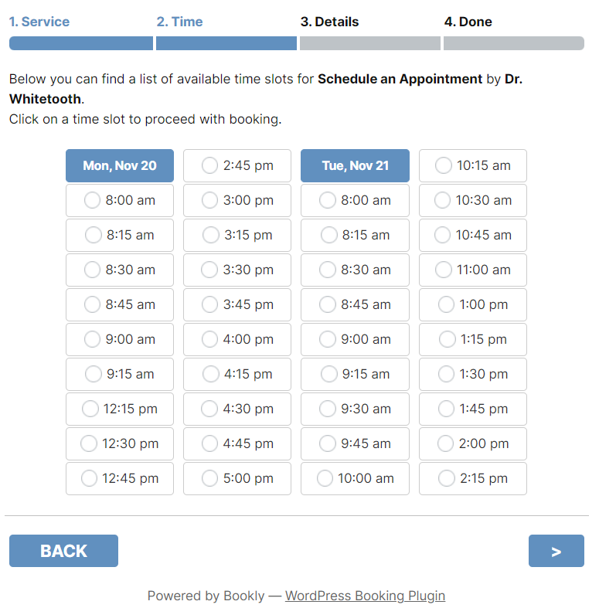
10:15, 11:15, and 1:45 appointment times on Nov 20 and 12:00 on Nov 21st are not available because they have already been scheduled for another patient (on next slides as well)

Slide 9


Slide 10
